Slide 1

Composing Workshop
WELCOME

Slide 2

Technology for Composition

Slide 3
OBJECTIVES
By the end of today you will be able to:
Use a MIDI sequencer
Use a MIDI controller keyboard
Layer parts together to create a composition
Blend sounds together through mixing
You might be able to:
Explore sound creation using synthesisers

Slide 4
SCHEDULE
Morning session
Introduce and setup technology
Begin to compose.
Add and layer parts to composition.
Lunch Break (30mins)
Afternoon session
Develop sounds within composition.
Listen to Compositions.
Guided tour and feedback

Slide 5


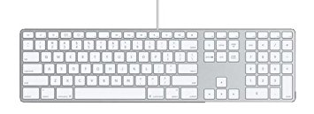
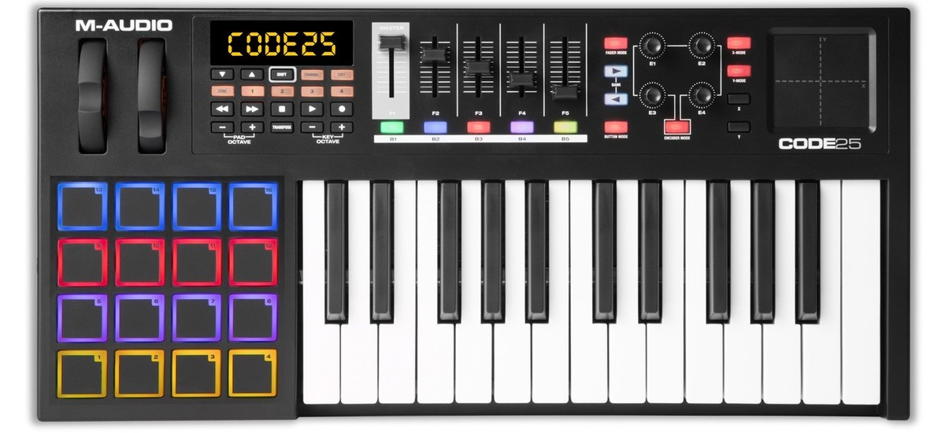
Introduce Technology
Apple imac
USB
Power button
(hold in)
Keyboard/mouse
MIDI Controller
Keyboard
(no sounds)

Slide 6
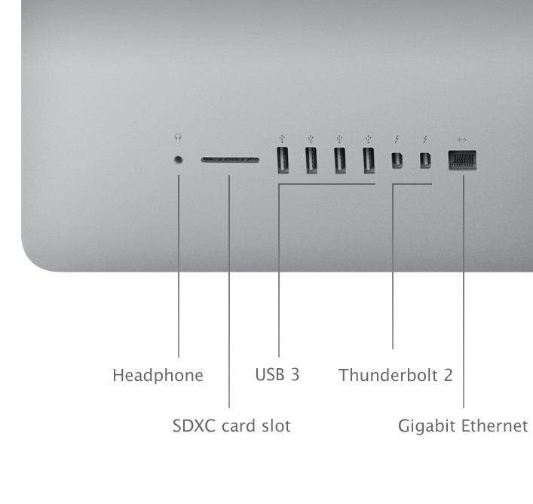
Headphone Socket
Rear of screen (right hand side)

Slide 7
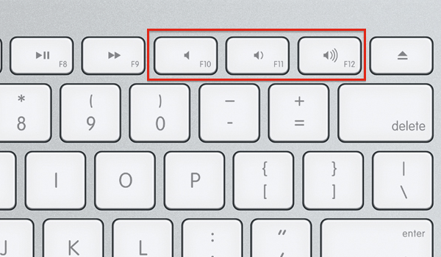
Sound Volume
Upper Keyboard; Close Up
Mute
Down
Up
(right hand side)

Slide 8
Logging On
Click your mouse, two boxes appear on screen
Name
Enter Password
Usernames (temporary)
Z1025226 , Z1025227 , Z1025228 , Z1025229 , Z1025230 , Z1025231 , Z1025232 , Z1025233 , Z1025234 , Z1025235 , Z1025236 , Z1025237 , Z1025238 , Z1025239 , Z1025240 , Z1025241 , Z1025242 , Z1025243 , Z1025244 , Z1025245
qp5j%cxe
Password

Slide 9


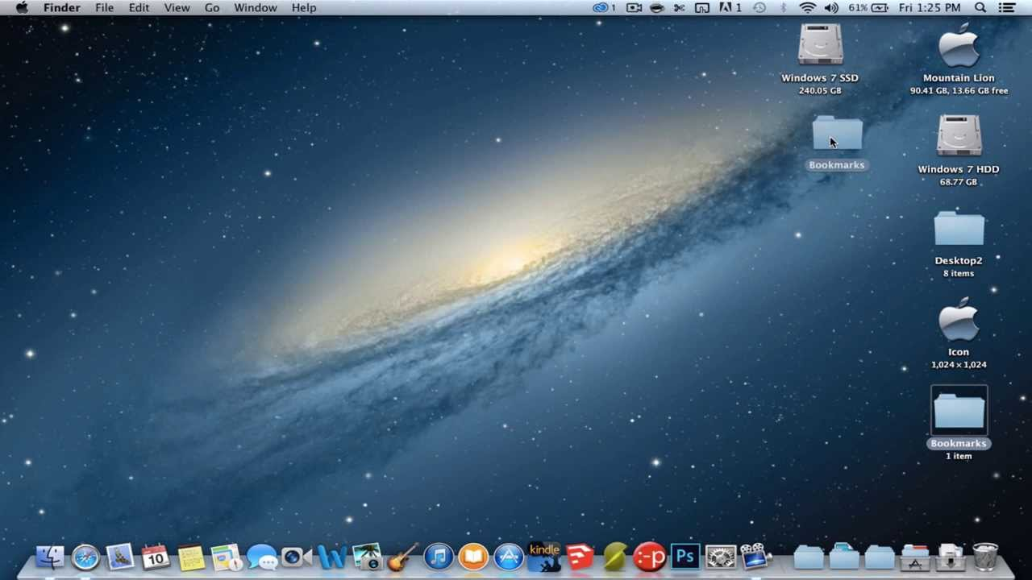
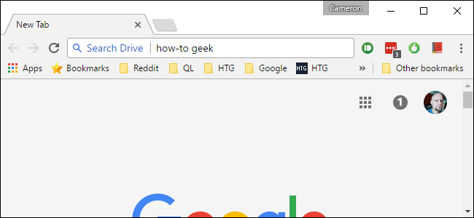
Accessing the Files
1. Open a Browser from the Dock at the bottom of your screen,
Chrome
Safari
2. Type the following text in the Address Bar
http://digmusic,github.io

Slide 10
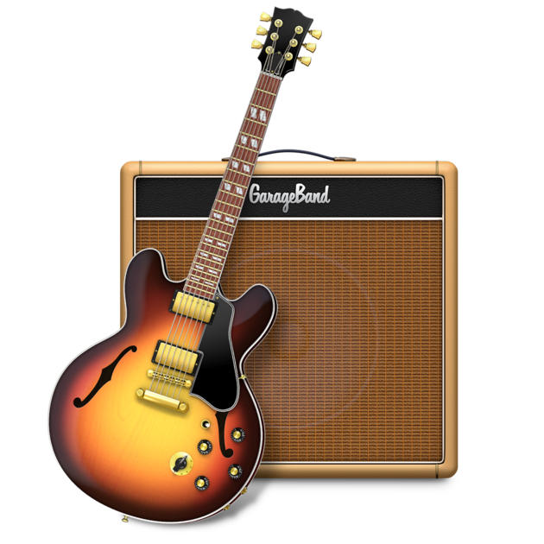
Garageband
The following workshop uses Garageband to create a music composition.
STEP 1
Download the file ‘Garageband Tutorial: How To Make A Basic Track’ to your computer.
You can now choose to follow this worksheet…….or follow the video tutorial.
(use your headphones)
STEP 2
Click the icon from the Dock at the bottom of the screen.
00:15secs into the video tutorial… is really the beginning of the workshop.

Slide 11

The Chord Progression
This section helps you get a chord sequence down for the basis of your composition.
00:15 – 4:50 Video reference
Create a Software Instrument Track
select a sound from the Library window: Piano?
2. Explore a chord sequence (for 4 bars).
explore the chords you like the sound of
….you do not need to try and copy the chords used in the video. Explore your own!
I V vi IV
C G Am F
(C Maj)
You might want to explore some common progressions\;
https://www.musical-u.com/learn/exploring-common-chord-progressions/

Slide 13

The Bass Line
This section helps you get a Bass line down for the chord progression you have chosen.
5:25 – 7:62 Video reference
Create another Software Instrument Track
select a sound from the Library window: Bass or Synth bass?
2. Explore a Bass line for the chords in your progression(for 4 bars).
explore the ROOT notes for the chords
consider the notes in a triad (3 note) chord…will these work?
….you do not need to try and copy the notes used in the video. Explore your own!

Slide 14

The Lead Line
This section helps you get a Lead down for the chord progression you have chosen.
7:02 – 10:10 Video reference
Create another Software Instrument Track
select a sound from the Library window: Synth Lead sound?
2. Explore a Lead line that seems to fit the chords in your progression.
explore the LEAD notes for the chords and explore the scale.
consider the notes in the scale you are using….do these work?
….you do not need to try and copy the notes used in the video. Explore your own!

Slide 15

The ‘Beats’
Get the ‘Beats’ down for the composition so far.
10:27-11:30 Video reference
Create another Software Instrument Track
select a sound from the Library window: Electronic Drum Kit sound?
2. Explore a lead line that seems to fit the chords in your progression.
explore the LEAD notes for the chords and explore the scale.
consider the notes in the scale….do these work?
….you do not need to try and copy the notes used in the video. Explore your own!

Slide 16
MIDI Drum Map
Each element of a MIDI drum kit is mapped to a different key on the keyboard as below:
C

Slide 17

Layering the ‘Kick’
This section helps you layer the KICK with the ‘Beats’ track.
11:30-13:20 Video reference
Create another Software Instrument Track
select a sound from the Library window: Electronic Drum Kit: Kick?
2. Explore layering up another Kick sound.
explore the Kick sounds that might fit with the existing Beats track.
consider the sound of each kick sound.
you might explore using EQ to blend the sounds together?

Slide 18

Layering the ‘Snare’
This section helps you layer the SNARE with the ‘Beats’ track.
11:30-13:20 Video reference
Create another Software Instrument Track
select a sound from the Library window: Electronic Drum Kit: Snare?
2. Explore layering up another Kick sound.
explore the Snare sounds that might fit with the existing Beats track.
consider the sound of each kick sound.
you might explore using VOLUME to blend the sounds together?

Slide 19
Mixing the ‘Snare’
This section helps you blend the Snare sound.
13:20-16:15 Video reference
1. Explore EQ on the Snare track.
Explore EQ to shape the Snare sounds that might fit with the existing Beats track.
consider the sound of each Snare sound.
you might explore using EQ to blend the sounds together?
Removing High frequencies with EQ to help blend

Slide 20
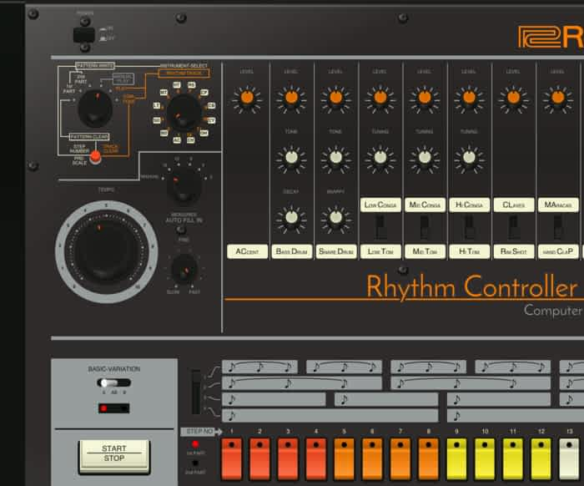
Adding an ‘808 Clap’
This section helps you blend a classic ‘808 Clap’
16:15- Video reference
Create another Software Instrument Track
select a sound from the Library window: Electronic Drums: 808?
2. Explore layering up another Kick sound.
explore the Clap sounds that might fit with the existing Beats track.
consider the sound of each Snare Clap sound.
you might explore using EQ or Volume to blend the sounds together?

Slide 21
Blending additional parts
This section helps you to continue your composition development.
17:20 onwards Video reference
Create additional audio and MIDI Tracks
explore Audio Loop sounds that you feel fit your composition
2. Explore Audio Loops, EQ and Automation
Explore Audio Loops
consider how Audio Loops may layer and blend your sounds together.
you might explore how these can be blended together through EQ and Automation.

Slide 22

Your Composition
Export your composition as an audio file.
17:20 onwards Video reference
Create additional audio and MIDI Tracks
explore Audio Loop sounds that you feel fit your composition
2. Explore Audio Loops, EQ and Automation
Explore Audio Loops
consider how Audio Loops may layer and blend your sounds together.
you might explore how these can be blended together through EQ and Automation.

Slide 23
SUMMARY
Do you feel able to:
Use a MIDI sequencer
Use a MIDI controller keyboard
Layer parts together to create a composition
Blend sounds together through mixing
Do you feel able to:
Explore sound creation using synthesisers

Slide 24
We hope you have enjoyed the workshop
THE END

